Slide 1
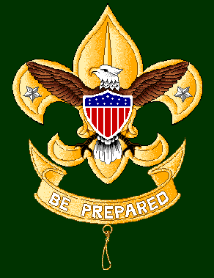
SCOUT
JEOPARDY
Notes:
Intro screen

Slide 2
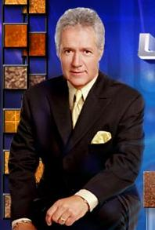
Notes:
Host screen

Slide 3
Knots 1 | Finding Your Way | First Aid Tenderfoot | First Aid 2nd Class | Scouting Basics 1 | Knots 2
$200 | $200 | $200 | $200 | $200 | $200
$400 | $400 | $400 | $400 | $400 | $400
$600 | $600 | $600 | $600 | $600 | $600
$800 | $800 | $800 | $800 | $800 | $800
$1000 | $1000 | $1000 | $1000 | $1000 | $1000
Notes:
Jeopardy round

Slide 4

First Aid 1st Class | Wilderness Survival | Camping & Cooking | Maps and Compass | Scouting Basics 2 | LNT
$400 | $400 | $400 | $400 | $400 | $400
$800 | $800 | $800 | $800 | $800 | $800
$1200 | $1200 | $1200 | $1200 | $1200 | $1200
$1600 | $1600 | $1600 | $1600 | $1600 | $1600
$2000 | $2000 | $2000 | $2000 | $2000 | $2000
Notes:
Double Jeopardy Round

Slide 5
Final Jeopardy
Identifying Plants and Animals
Notes:
Final Jeopardy betting screen

Slide 6
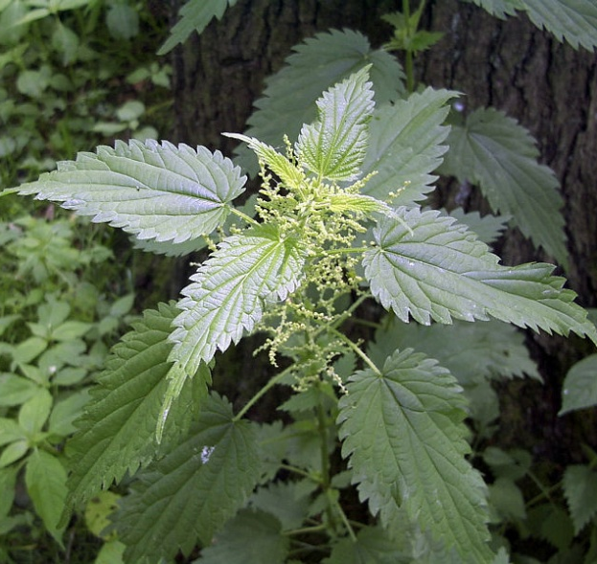
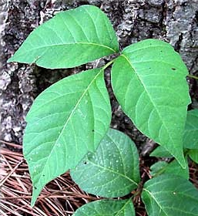
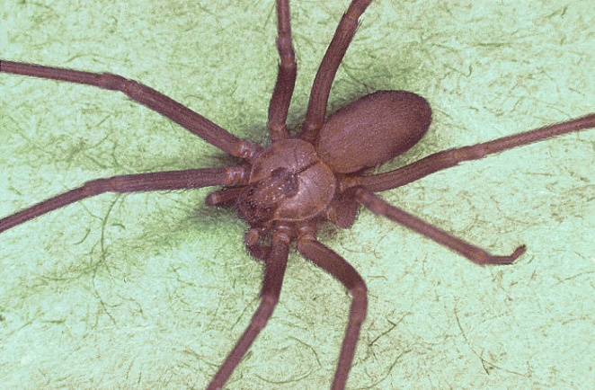
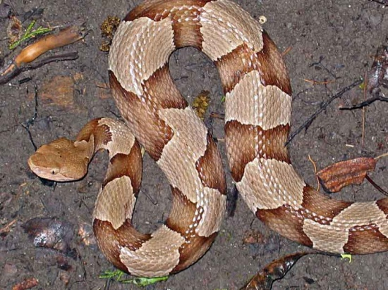

Final Jeopardy
A. Stinging Nettle, B. Poison Ivy, C. Brown Recluse Spider, D. Copperhead Snake
Identify the following:
B
C
A
D
Notes:
Final Jeopardy

Slide 7
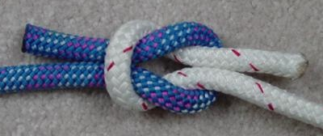
$200
Demonstrate how to tie a square knot
Notes:
Single Jeopardy – Category 1

Slide 8
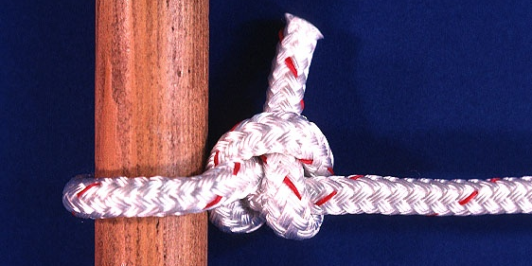
$400
Demonstrate how to tie a two-half hitch
Notes:
Single Jeopardy – Category 1

Slide 9
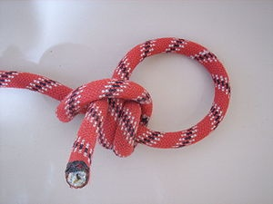
$600
Demonstrate how to tie a taut line hitch
Notes:
Single Jeopardy – Category 1

Slide 10
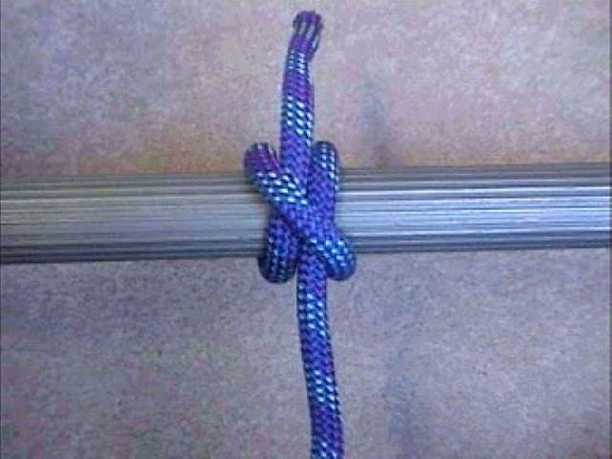
$800
Demonstrate how to tie a clove hitch.
Notes:
Single Jeopardy – Category 1

Slide 11
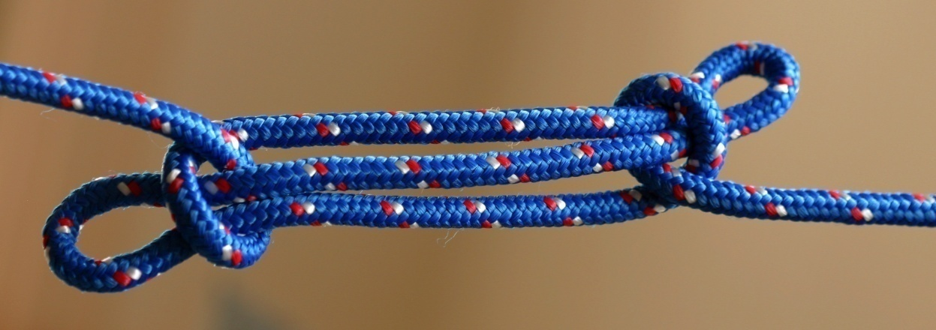
$1000
Demonstrate how to tie a sheep shank knot.
Notes:
Single Jeopardy – Category 1

Slide 12
$200
Stay calm, Think, Observe, Plan
If you become lost, you should stop and follow the STOP steps. What does STOP stand for?
Notes:
Single Jeopardy – Category 2

Slide 13
$400
Locate the North Star; Observe the rising and setting of the moon (rises in the east and sets in the west.
Name two methods for finding north at night.
Notes:
Single Jeopardy – Category 2

Slide 14
$600
Explain what is meant by maps having 2 north’s and why it is important to know.
Magnetic north and true north. Maps are usually drawn with true north but a compass reads magnetic north. You need to understand declination to properly orient a map.
Notes:
Single Jeopardy – Category 2

Slide 15
$800
Where are you going. When will you return. Who is going with you. Why your are going. What are you taking
Explain the 5 W’s of a trip plan.
Notes:
Single Jeopardy – Category 2

Slide 16
$1000
Rising and setting of the sun, watch method, shadow stick method.
Explain 3 methods for finding north during the day.
Notes:
Single Jeopardy – Category 2

Slide 17
$200
When someone is choking and cannot speak, cough, or breathe.
Explain when to use the Heimlich maneuver.
Notes:
Single Jeopardy – Category 3

Slide 18
$400
Explain first aid for small cuts and scratches.
Wash the area with soap and water, apply an antiseptic, and keep the wound clean with a bandage.
Notes:
Single Jeopardy – Category 3

Slide 19
$600
Stop hiking as soon as you feel a hot spot. Drain fluid if present by piercing the side with a sterile needle and clean the area thoroughly. Shape a piece of moleskin into a donut and place it over the blister. Cover the area with duct tape.
Explain first aid for blisters on your feet.
Notes:
Single Jeopardy – Category 3

Slide 20
$800
Explain the first aid for a nosebleed.
Have the victim sit up and lean forward to prevent blood from draining into their throat. Pinch the nostrils together to maintain pressure on the flow. Apply a cool, wet cloth to the victim’s nose and face.
Notes:
Single Jeopardy – Category 3

Slide 21
$1000
Explain how to administer first aid for frostbite.
Get the victim in a warm dry place, warm the area with the palm of your hand (do not rub), put the area against your skin (armpit or belly), put the area in warm (not hot) water, get to a doctor.
Notes:
Single Jeopardy – Category 3

Slide 22
$200
Explain the first aid for a second degree burn.
Place the injury in cool water until the pain goes away. Let the burn dry, then protect it with a sterile gauze pad. Do not pop the blisters and do not apply creams, ointments, or sprays.
Notes:
Single Jeopardy – Category 4

Slide 23
$400
Hot, dry, red skin with rapid pulse, confusion, irritability, and possibly unconsciousness.
Describe the symptoms of heatstroke.
Notes:
Single Jeopardy – Category 4

Slide 24
$600
Explain how to remove a fishhook when you can’t get to a doctor.
Push the hook farther in until the barb comes through the skin. Snip off the barb with pliers or wire cutters. Ease the shank of the hook back out through the point of entry. Wash and bandage the wound.
Notes:
Single Jeopardy – Category 4

Slide 25
$800
Explain the first aid for a puncture wound.
Encourage the wound to bleed to help flush the wound. Use sterilized tweezers to pull out the object. Wash the area with soap and water. Apply a sterile bandage. Get the victim to a doctor.
Notes:
Single Jeopardy – Category 4

Slide 26
$1000
Identify at least 4 symptoms of shock.
A feeling of weakness; Confusion, fear, dizziness; Skin that is moist, clammy, cool, and pale; A quick, weak pulse; Shallow, rapid, and irregular breathing; Nausea and vomiting; Extreme thirst.
Notes:
Single Jeopardy – Category 4

Slide 27
$200
Safety! It’s a way to look after each other.
Explain why we use the Buddy System.
Notes:
Single Jeopardy – Category 5

Slide 28
$400
Recite the Scout Oath and Law.
On my honor I will do my best to do my duty to God and my country and to obey the Scout Law; to help other people at all times; to keep myself physically strong, mentally awake, and morally straight.
A Scout is trustworthy, loyal, helpful, friendly, courteous, kind, obedient, cheerful, thrifty, brave, clean, and reverent.
Notes:
Single Jeopardy – Category 5

Slide 29
$600
Describe 3 procedures for safe knife use.
Keep the blades closed except when you are using them. Cut away from yourself. Close the blades before you pass a knife to someone else. Keep your knife sharp and clean.
Notes:
Single Jeopardy – Category 5

Slide 30
$800
Swimming rescues are dangerous. Explain 2 other water rescue methods.
Reaching with an arm, leg, stick or other object. Throwing lines or objects.
Notes:
Single Jeopardy – Category 5

Slide 31
$1000
What are the requirements for the Rank of Eagle Scout?
Earn a total of 21 merit badges of which 11 are required. While a Life Scout actively serve for 6 months in a position of responsibility. While a Life Scout, plan, develop, and give leadership to others in a service project.
Notes:
Single Jeopardy – Category 5

Slide 32
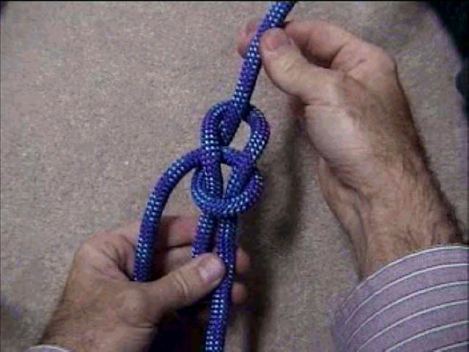
$200
Demonstrate how to tie a bow line knot.
Notes:
Single Jeopardy – Category 6

Slide 33
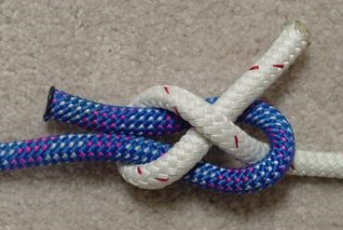
$400
Demonstrate how to tie a sheet bend knot.
Notes:
Single Jeopardy – Category 6

Slide 34
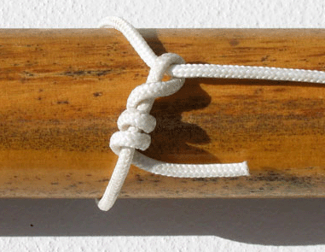
$600
Demonstrate how to tie a timber hitch.
Notes:
Single Jeopardy – Category 6

Slide 35
$800
Often called the rescue knot, it is a non-slipping knot that is easily untied.
What is the purpose of the bow line knot?
Notes:
Single Jeopardy – Category 6

Slide 36
$1000
To tie two ropes of different diameters together.
What is the purpose of the sheet bend knot?
Notes:
Single Jeopardy – Category 6

Slide 37
$400
Closed fractures do not cut through the skin while open fractures do pierce the skin.
Explain the difference between a closed (simple) fracture and an open (compound) fracture.
Notes:
Double Jeopardy – Category 1

Slide 38
$800
Explain first aid for animal bites.
Scrub the bite with soap and water to remove saliva. Cover the wound with a sterile bandage and get the victim to a doctor. Do not try to catch the animal.
Notes:
Double Jeopardy – Category 1

Slide 39
$1200
What are four symptoms of a broken bone?
There is an abnormal shape or position of a bone or joint. There is swelling or a bluish color at the facture site. The victim might have hear or felt a bone snap. The victim feels pain when you press on the skin over the fracture. The victim might not be able to move the injured limb.
Notes:
Double Jeopardy – Category 1

Slide 40
$1600
Uncomfortable pressure in the center of the chest, unusual sweating, nausea, shortness of breath, a feeling of weakness.
Describe the 5 warning signs of a heart attack.
Notes:
Double Jeopardy – Category 1

Slide 41
$2000
Explain the first aid for stopped breathing
Open the airway. If the airway seems to be open and the victim is still not breathing, begin rescue breathing. If the victim’s chest doesn’t rise, recheck the airway and perform the Heimlich maneuver. Resume rescue breathing; continue until medical help arrives and tells you to stop.
Notes:
Double Jeopardy – Category 1

Slide 42
$400
Boiling, purification tablets, and filters.
What are the three methods of purifying water?
Notes:
Double Jeopardy – Category 2

Slide 43
$800
Knife, first aid kit, extra clothing, rain gear, water bottle, flashlight trail food, matches/fire starters, sun protection, map and compass.
Name five of the ten outdoor gear essentials.
Notes:
Double Jeopardy – Category 2

Slide 44
$1200
Give 3 wet-weather fire building tips.
Gather wood before the rain begins, keep dry tinder in a plastic bag, split wet logs, keep matches dry in a plastic bag, look above ground (in trees) for wood, use a lighter or candle to start a fire.
Notes:
Double Jeopardy – Category 2

Slide 45
$1600
Explain at least 3 rules of safe hiking when going cross country.
Watch where you place your feet to avoid slipping or twisting an ankle. Wade through water only if there is no other way to go, and only if the water is shallow and the current is not too swift. Unfasten the hip belt of your backpack before crossing a stream. Detour around areas that appear to be dangerous or go back.
Notes:
Double Jeopardy – Category 2

Slide 46
$2000
Do not run away. Do not look the bear in the eyes. Back away slowly while talking in a calm voice. Do not drop your pack. If attacked by a grizzly protect your neck and head with your arms and play dead. If attacked by a black bear, fight back aggressively.
Explain what to do or not do if you suddenly encounter a bear in the back country.
Notes:
Double Jeopardy – Category 2

Slide 47
$400
Avoid getting blisters by wearing shoes or boots that fit properly, by changing your socks when they are sweaty or wet, and by paying attention to how your feet feel (hot spots.)
Explain how to avoid blisters on your feet.
Notes:
Double Jeopardy – Category 3

Slide 48
$800
Identify 3 ways to avoid bear encounters in the back country.
Store all smellables and garbage in a bear canister or hang in a bear bag. Cook 100 yards downwind from your tent. No food in tents. Do not wear the clothes you cook in to bed. Make noise while on the trail so you don’t surprise a bear.
Notes:
Double Jeopardy – Category 3

Slide 49
$1200
Explain what tinder, kindling and fuel wood are.
Tinder is small, catches fire easily, and burns fast. Kindling is small twigs no thicker than a pencil and is used to get the fire going. Fuel is larger wood used to keep a fire going and to create coals for cooking on.
Notes:
Double Jeopardy – Category 3

Slide 50
$1600
Recite the Outdoor Code
As an American, I will do my best to – Be Clean in my outdoor manners, Be Careful with fire, Be Considerate in the outdoors, and Be Conservation-Minded.
Notes:
Double Jeopardy – Category 3

Slide 51
$2000
Recite the Outdoor Code
As an American, I will do my best to – Be Clean in my outdoor manners, Be Careful with fire, Be Considerate in the outdoors, and Be Conservation-Minded.
Notes:
Double Jeopardy – Category 3

Slide 52
$400
North or true north arrow, distance scale (for measuring distances), map scale (compares the size of the map to the area it represents), date (when the map was drawn or updated.
Aside from the map legend, explain two other types of information found in a maps margins.
Notes:
Double Jeopardy – Category 4

Slide 53
$800
Every fifth contour line is darker than the other four. This index line shows you the elevation above sea level.
What are the index lines on a topographic map?
Notes:
Double Jeopardy – Category 4

Slide 54
$1200
Identify the following map symbols:
Marsh, intermittent stream, trail, depression, mine, unimproved road
Notes:
Double Jeopardy – Category 4

Slide 55
$1600
Describe 4 topographical features that can be determined from the contour lines.
Moving from one contour line to another always indicates a change in elevation. The closer contour lines are to one another, the steeper the slope is. A series of closed contours (the contours make a circle) represents a hill. If the closed contours are hatchured it indicates a closed depression. Contour lines crossing a stream valley will form a "V" shape pointing in the uphill (and upstream) direction.
Notes:
Double Jeopardy – Category 4

Slide 56
$2000
What is declination and how do you adjust for it on a map?
Declination is the difference between magnetic north and true north. Check the map margins to see what the declination is. To adjust your compass reading to get a true north bearing, use the following rules: If the declination is labeled east, add the declination degrees to your compass reading. If the declination is labeled west, subtract the declination degrees from your compass reading.
Notes:
Double Jeopardy – Category 4

Slide 57
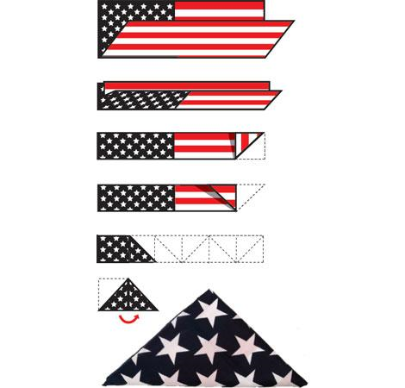
$400
Demonstrate how to fold an American Flag.
Notes:
Double Jeopardy – Category 5

Slide 58
$800
Describe the parts of the scout badge and what they mean.
The 3 points of the trefoil stand for the 3 parts of the Scout Oath. The eagle and shield stand for freedom and a Scout’s readiness to defend that freedom. The two stars symbolize truth and knowledge. The shape of the badge means that a Scout can point the right way in life. The scroll bearing the scout motto is turned up at the edges as a reminder that a Scout smiles as he does his duty. The knot at the bottom of the scroll represents the Scout Slogan, Do a Good Turn Daily.
Notes:
Double Jeopardy – Category 5

Slide 59
$1200
Qualified supervision. Physical fitness. Safe area. Lifeguards on duty. Lookout. Ability groups. Buddy system. Discipline.
Explain 4 of the 8 points of a safe swim defense.
Notes:
Double Jeopardy – Category 5

Slide 60
$1600
Qualified supervision. Physical fitness. Swimming ability. PFD’s. Buddy system. Skill proficiency. Planning. Equipment.
Describe 4 of the 8 precautions that should be taken for a safe trip afloat.
Notes:
Double Jeopardy – Category 5

Slide 61
$2000
Name 4 lashings and tell when you would use them.
Square – To bind poles that touch and cross at a 45 to 90 degree angle. Shear – To bind poles where a flexible joint is needed. Diagonal – To bind poles that do not touch but cross each other at a 45 to 90 degree angle. Round – Bind 2 poles side by side (flagpole). Tripod – For making tripods. Floor – Secures the top of a table or the deck of a tower or raft.
Notes:
Double Jeopardy – Category 5

Slide 62
$400
Identify the 7 principles of LNT
Plan Ahead and Prepare
Travel and Camp on Durable Surfaces
Dispose of Waste Properly
Leave What You Find
Minimize Campfire Impacts
Respect Wildlife
Be Considerate of Other Visitors
Notes:
Double Jeopardy – Category 6

Slide 63
$800
Using LNT principles, what does it mean to dispose of wastes properly?
Pack it in, pack it out. Pack out all trash, leftover food, and litter.
Deposit solid human waste in catholes dug 6 to 8 inches deep at least 200 feet from water, camp, and trails. Cover and disguise the cathole when finished.
Pack out toilet paper and hygiene products.
To wash yourself or your dishes, carry water 200 feet away from streams or lakes and use small amounts of biodegradable soap. Scatter strained dishwater.
Notes:
Double Jeopardy – Category 6

Slide 64
$1200
Using LNT principles, how do you minimize campfire impacts?
Use a lightweight stove for cooking and enjoy a candle lantern for light. Where fires are permitted, use established fire rings, fire pans, or mound fires. Keep fires small. Only use sticks from the ground that can be broken by hand. Burn all wood and coals to ash, put out campfires completely, then scatter cool ashes.
Notes:
Double Jeopardy – Category 6

Slide 65
$1600
Using LNT principles, What does it mean to respect wildlife?
Observe wildlife from a distance. Do not follow or approach them.
Never feed animals. Feeding wildlife damages their health, alters natural behaviors, and exposes them to predators and other dangers.
Protect wildlife and your food by storing rations and trash securely.
Control pets at all times, or leave them at home.
Avoid wildlife during sensitive times: mating, nesting, raising young, or winter.
Notes:
Double Jeopardy – Category 6

Slide 66
$2000
Using LNT principles, how do you travel and camp on durable surfaces?
Durable surfaces include established trails and campsites, rock, gravel, dry grasses or snow. Protect riparian areas by camping at least 200 feet from lakes and streams.
In popular areas: Concentrate use on existing trails and campsites.
Walk single file in the middle of the trail, even when wet or muddy.
Keep campsites small. Focus activity in areas where vegetation is absent.
In pristine areas: Disperse use to prevent the creation of campsites and trails. Avoid places where impacts are just beginning.
Notes:
Double Jeopardy – Category 6

Slide 67
Daily
Double
Reaching with an arm, leg, stick or other object. Throwing lines or objects.
Swimming rescues are dangerous. Explain 2 other water rescue methods.
Notes:
Single Jeopardy Daily Double

Slide 68
Daily
Double
Explain what tinder, kindling and fuel wood are.
Tinder is small, catches fire easily, and burns fast. Kindling is small twigs no thicker than a pencil and is used to get the fire going. Fuel is larger wood used to keep a fire going and to create coals for cooking on.
Notes:
Double Jeopardy First Daily Double

Slide 69
Daily
Double
Identify the following map symbols:
Marsh, intermittent stream, trail, depression, mine, unimproved road
Notes:
Double Jeopardy Second Daily Double

Slide 70
THE SCOUT
JEOPARDY
CHAMPIONS
Notes:
Goodbye screen

